Slide 1
Mini-Research Project
By: Myron Willock

Slide 2
Discussion with Interviewee
How he feels neglected in his residential hall
Network issues off campus are over looked
How he feels hindered to campus due to unreliable connectivity
Dormitory Connection Limitations
Unable to complete timed assignments
Students have to travel to the Library for an stable connection
Would like to see
Strong network connections anywhere on DSU premise
Application that alerts users when new mail/packages come in

Slide 3
Interview Questions
Where do you complete majority of your assignments?
If the Library, why there? If your dormitory, do you feel the network effects your productivity?
Do you feel like DSU’s network have peak and down times? Certain times of the day where the network is slower?
Notes:
The importance of these question: Are its allows me to understand where the user is most comfortable when their being studious. Figure out if there affected by network issue to see if these questions are something relatable to them. Opens the opportunity to allow the interviewee to discuss where and when they had to deal with larger network issues

Slide 4
Problem?
Notes:
DSU’s network is widely spread among the university, located on campus but also accessible off campus at two different locations such as the University Court Yards and Living Learning Commons. Student’s with off campus housing feel as if their network needs/requirements that their paying for aren’t’ being met.
For this project ill be looking into overall network delay, duplicate Acks, explore protocol delay etc…

Slide 5


What Ill be using
Notes:
Ill be utilizing Wireshark and it’s features. I/O Graph’s, Export information (log), Network baselines on different time frames of campus

Slide 6
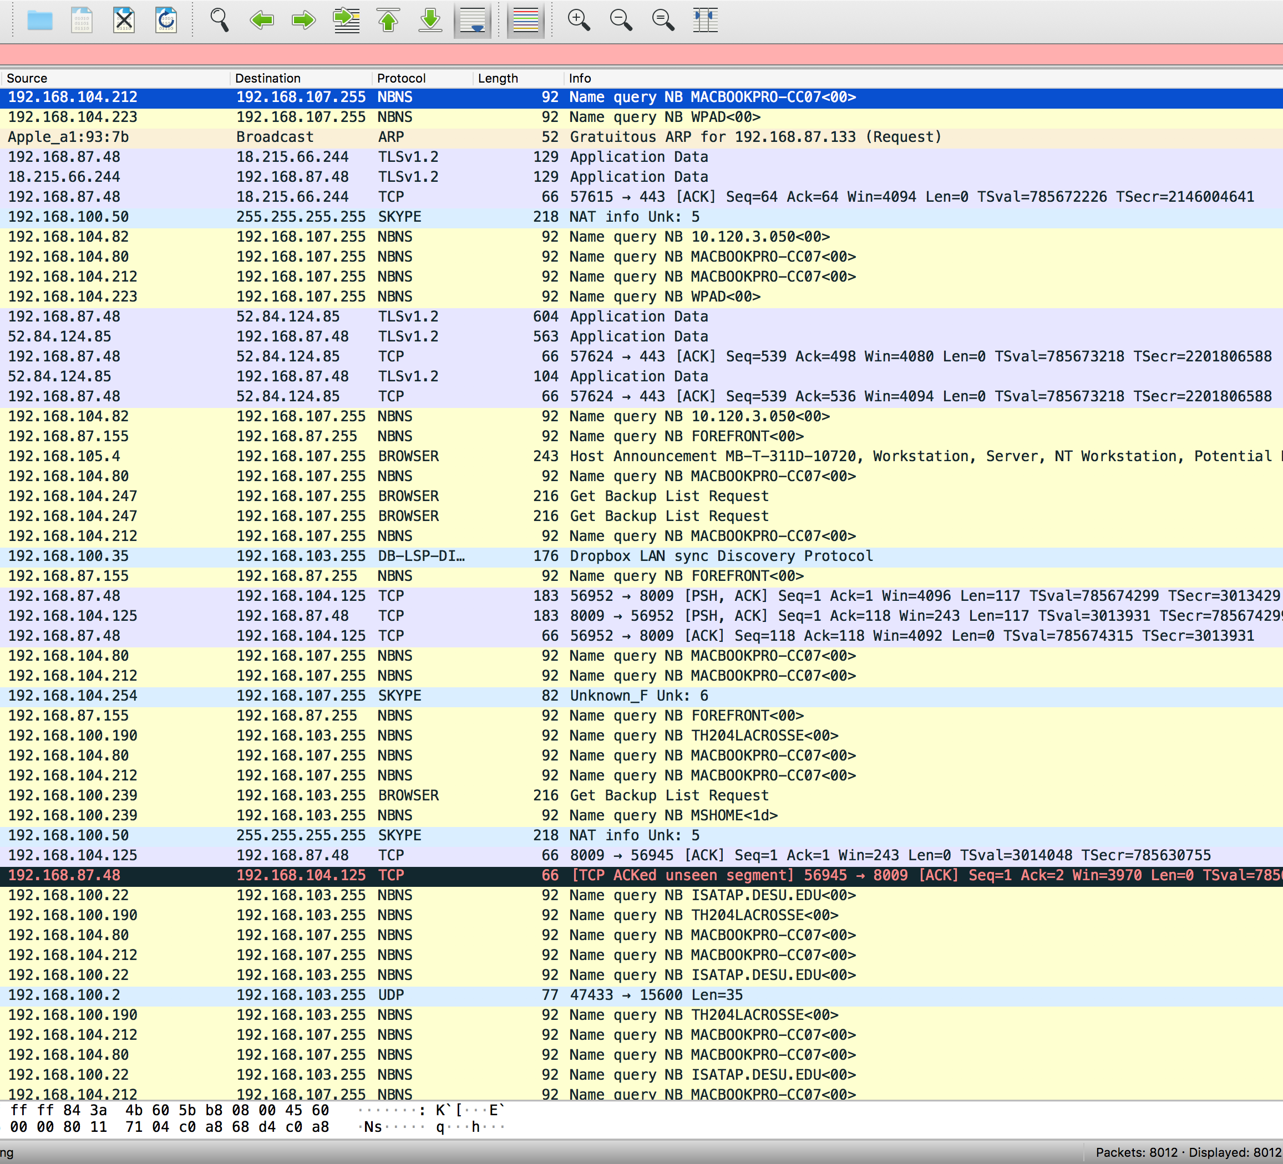
Experimental Procedure
What will I be measuring

Slide 7

Experimental Procedure cont.
When & Where will I be measuring?

Slide 8
Next Step?
Utilize Wireshark's different tools to identify issues
Expert Information Log
I/O Graphs
Analyze network protocols
Which protocols can effect network performance
Create a Network Baselines based time frames

Slide 9
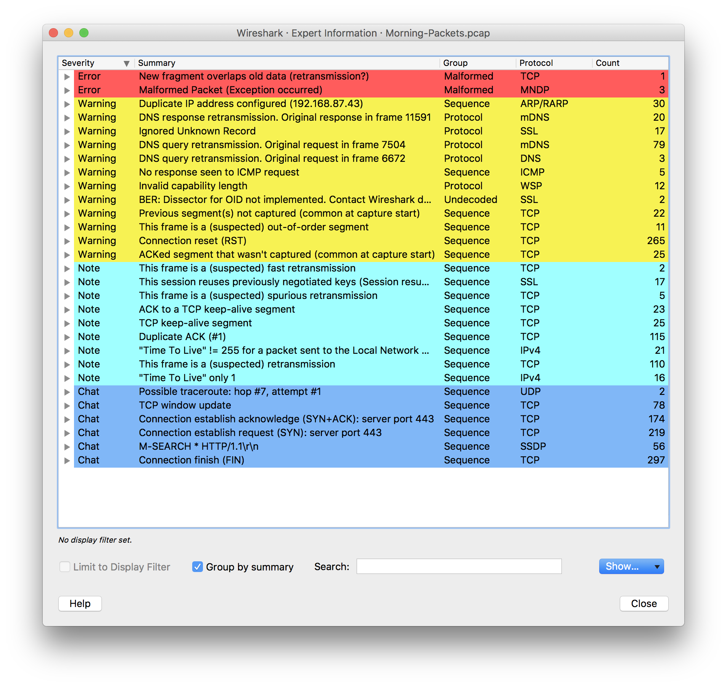
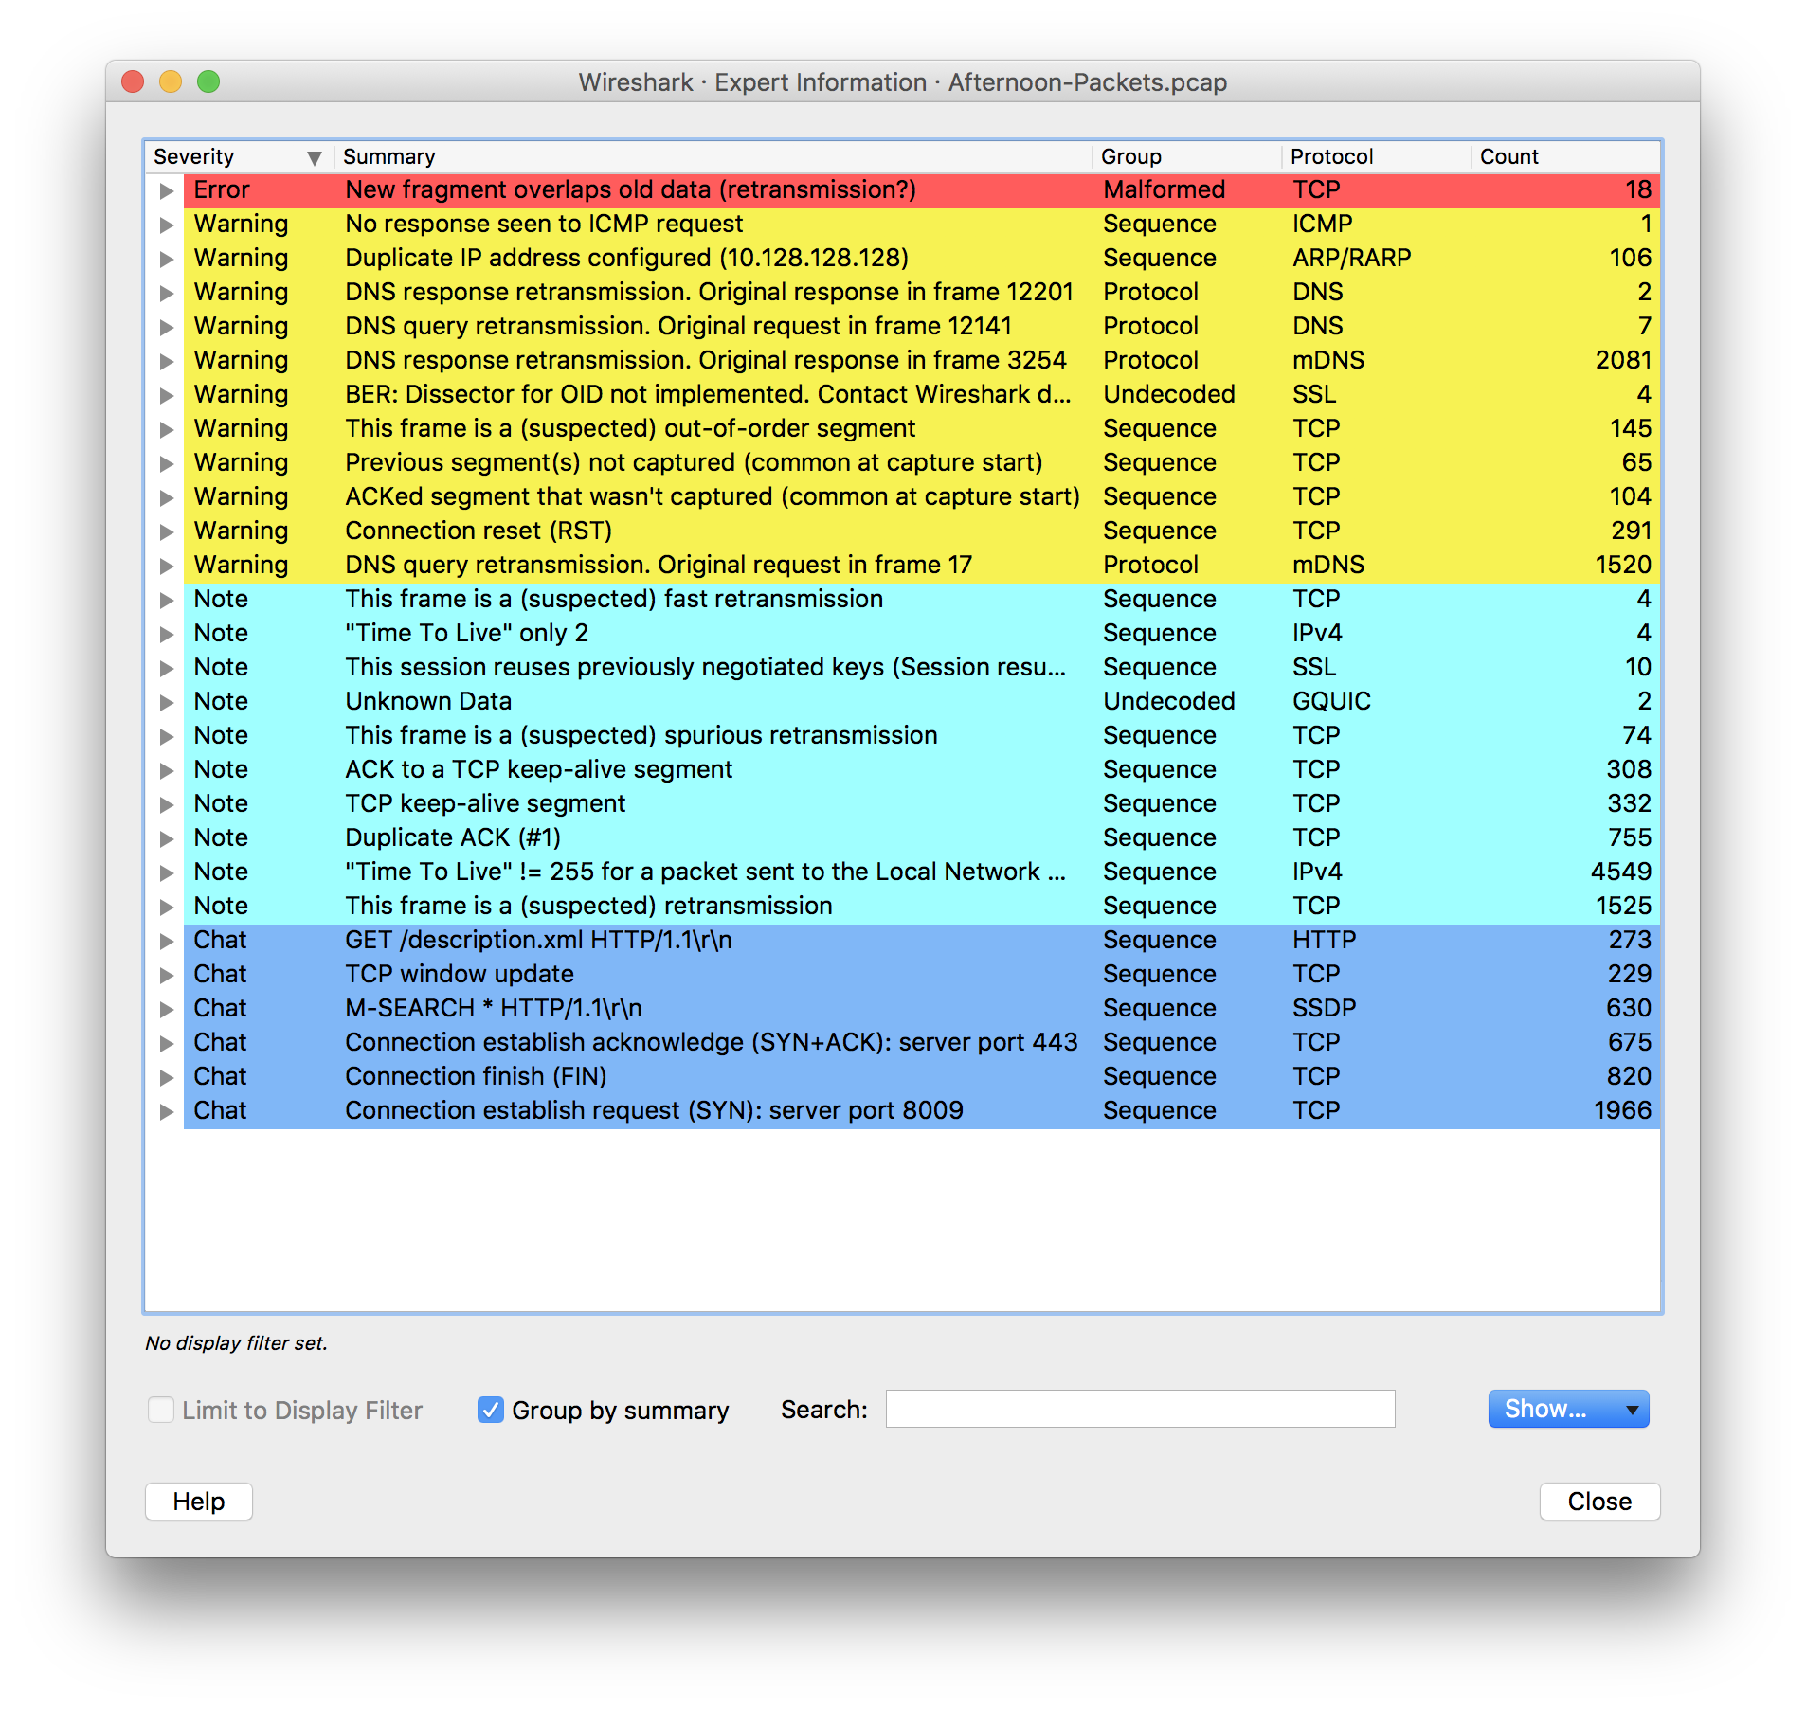
Error Logs

Slide 10
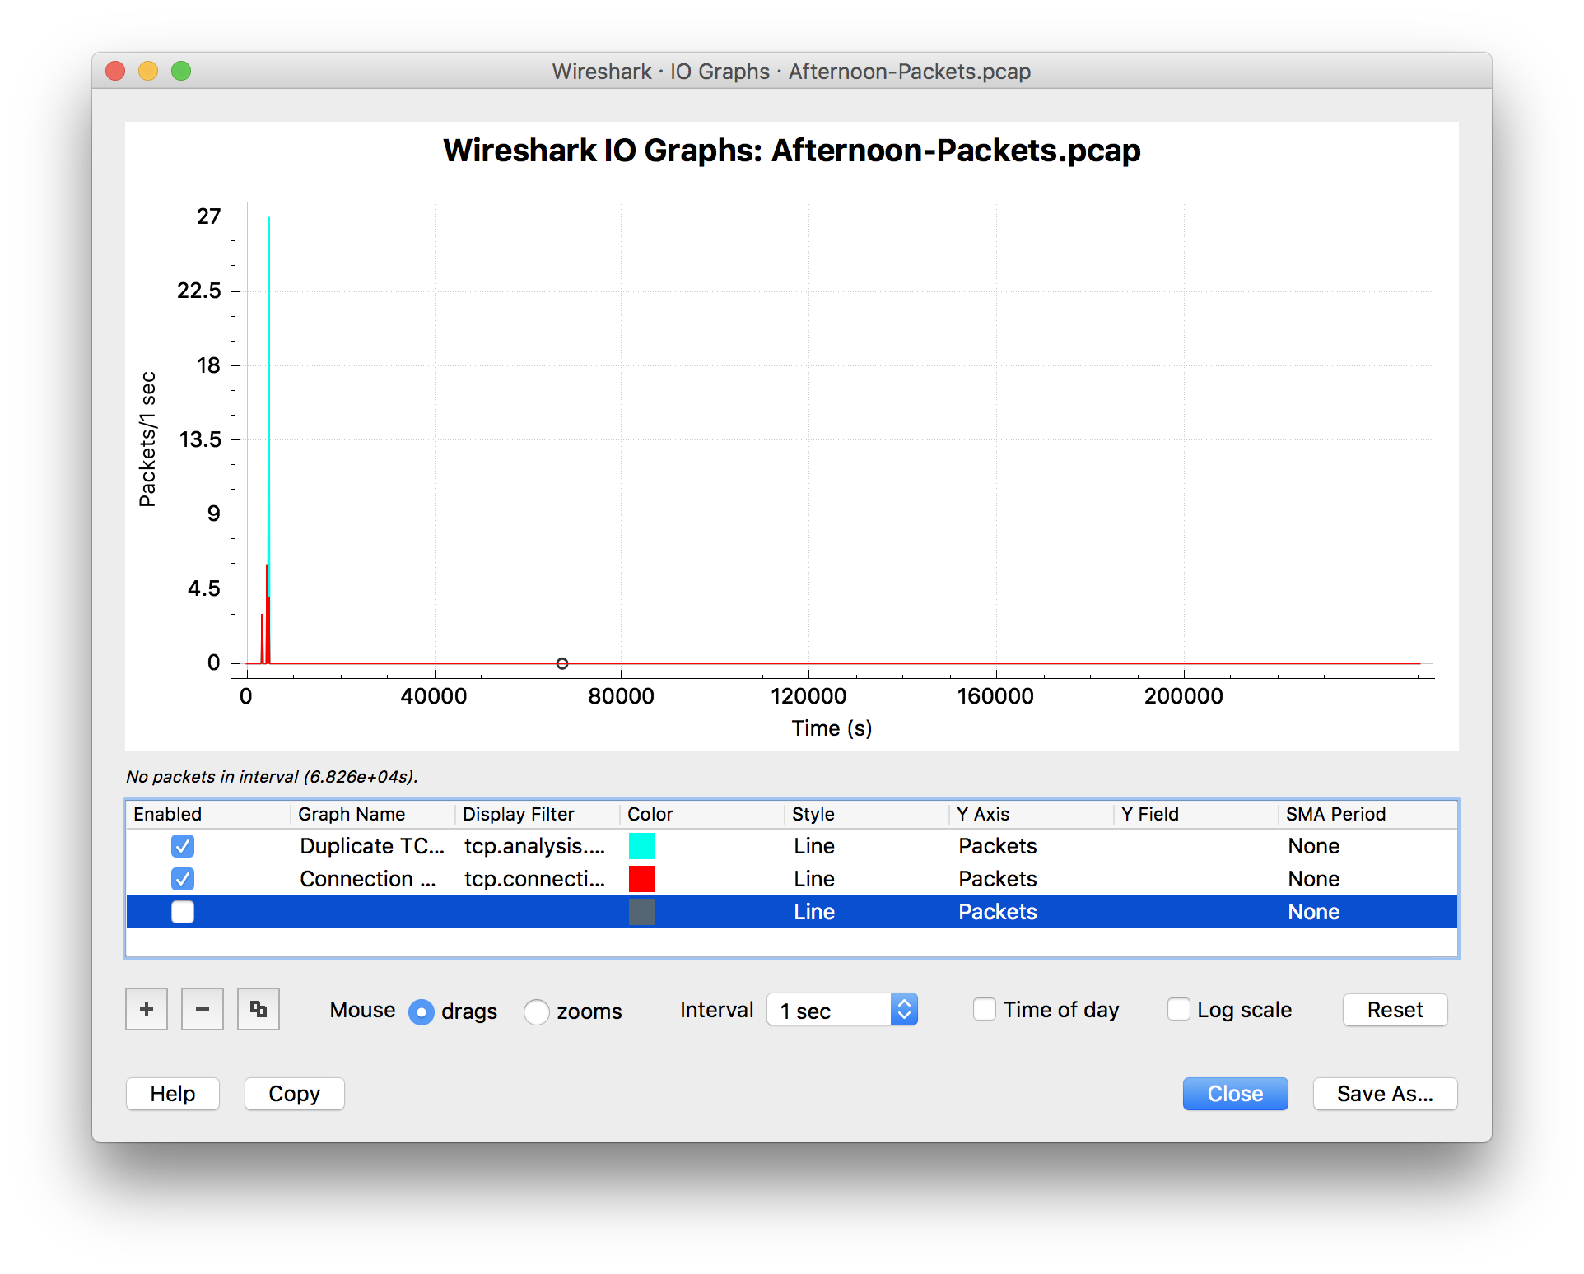
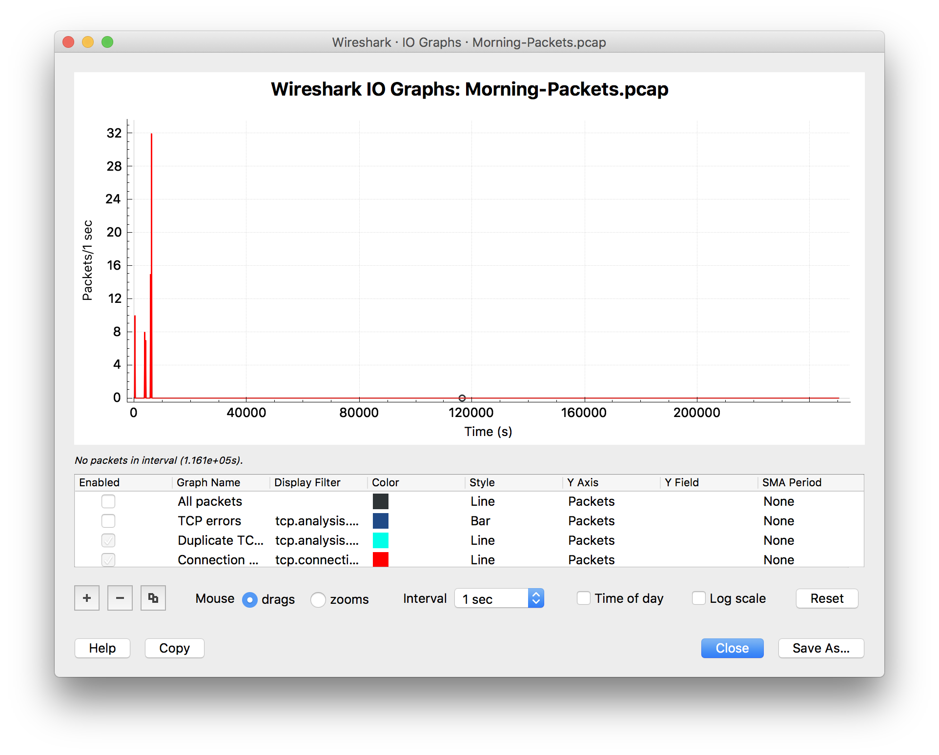
I/O Graphs

